Slide 1
Programming Paradigms
“Premature optimization is the root of all evil”
- Donald Knuth
CS 3022 – Object Lifetime
Notes:
Many of these slides were adapted from a course given by Stephen Schulz.

Slide 2
Object Lifetime
Creation of objects
Creation of bindings
References to variables, subroutines, types, and so on, all of which use bindings
Deactivation and reactivation of bindings that may be temporarily unusable
Destruction of bindings
Destruction of objects
Binding lifetime: The period of time between the creation and the destruction of a name-to object binding.
Object lifetime: The time between the creation and destruction of an object.

Slide 3
Storage allocation
1. Static objects are given an absolute address that is retained throughout the program's execution.
2. Stack objects are allocated and deallocated in last-in, first-out order, usually in conjunction with subroutine calls and returns.
3. Heap objects may be allocated and deallocated at arbitrary times. They require a more general (and expensive) storage management algorithm.

Slide 4
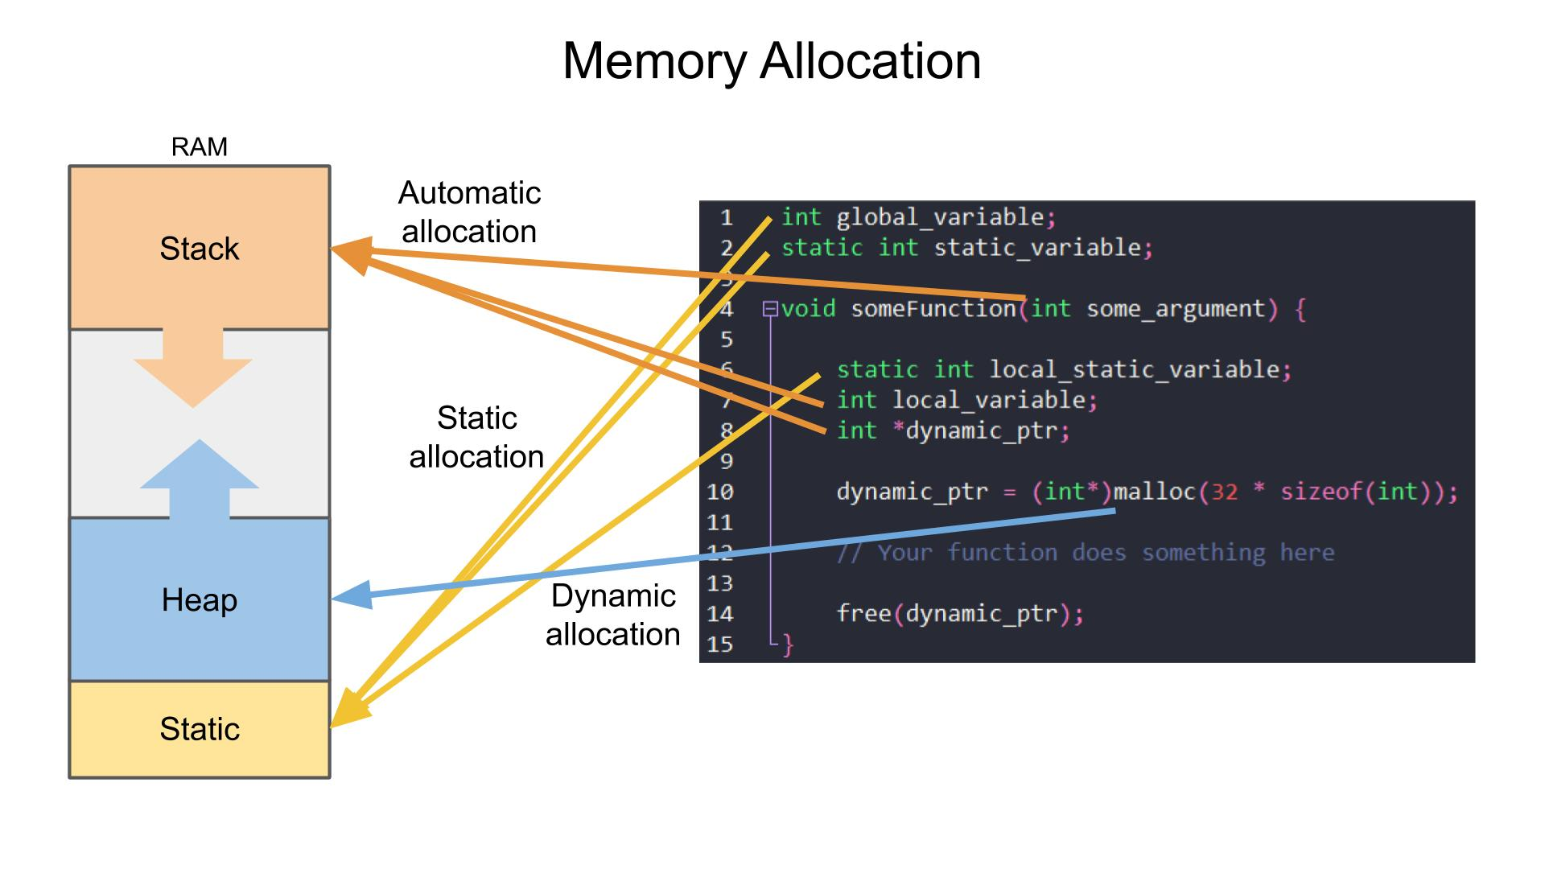
Static allocation
• Memory allocated at compile time, not runtime
• Global variables are the most common example
• Instructions, constants, and compiler-generated tables are also statically allocated
• Often placed in protected, read-only memory to prevent modification
Notes:
Image credit: https://www.digikey.es/en/maker/projects/introduction-to-rtos-solution-to-part-4-memory-management/6d4dfcaa1ff84f57a2098da8e6401d9c?srsltid=AfmBOooDjPeKZKp9OLVddxGbBmGWJmVp65LjHh-J3bf0-hXZDjmyaBMk

Slide 5
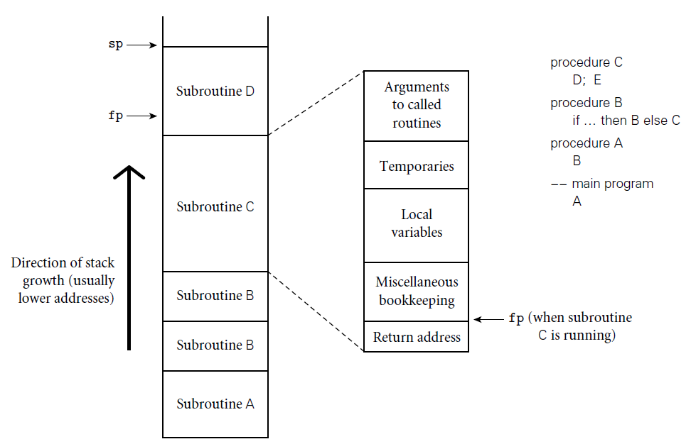
Stack allocation
Recursion makes static allocation impossible since multiple instances of the same local variable may exist simultaneously.
A stack provides a natural solution due to the nested structure of subroutine calls.
Each subroutine call gets its own frame on the stack.
Stacks usually grow downward (toward lower addresses).
Stack allocation reuses memory efficiently, requiring less total space than static allocation.

Slide 6
Heap allocation
The heap is a memory region where blocks can be allocated and deallocated at arbitrary times.
Essential for dynamic structures like linked lists, general strings, sets, and resizable data.
Not to be confused with Heap data structure (unfortunate homograph).

Slide 7
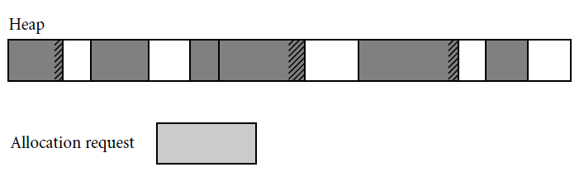
Heap allocation
Fragmentation issues:
Internal fragmentation: block allocated is larger than needed → wasted space inside block.
External fragmentation: free space exists but scattered into small pieces → cannot satisfy large requests.
Free list management:
First Fit: pick the first sufficiently large block.
Best Fit: search for the smallest adequate block.
Trade-off: best fit preserves large blocks but costs more time and may create many small leftover blocks.

Slide 8
Heap allocation
Problem of external fragmentation:
Even with multiple free lists, over time the heap may become fragmented.
Example: “checkerboarding” (alternating free/allocated blocks).
Solution: Heap compaction — moving allocated blocks to create larger free spaces.
Compaction is difficult because all references to moved blocks must be updated.

Slide 9
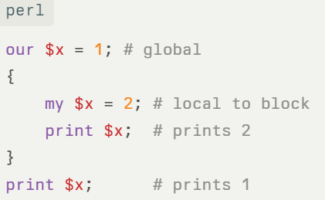
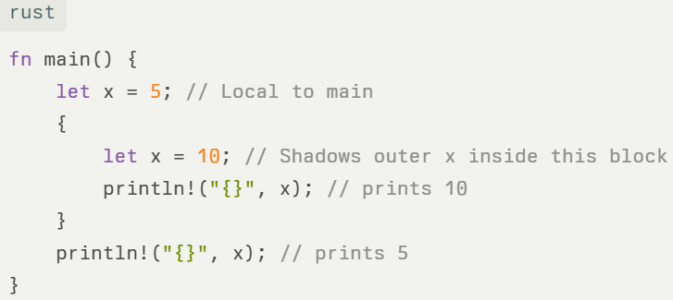
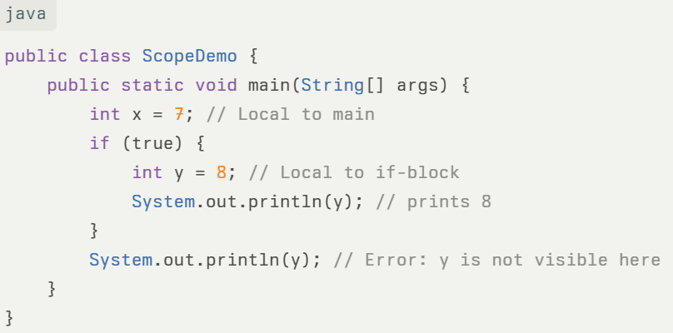
Scope – region where a binding is active

Slide 10
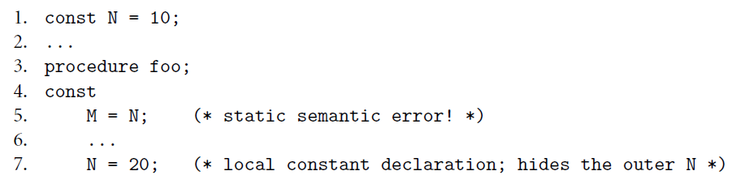
Weird Pascal scoping example
Local variables are over-ride global variables, no matter where declared. Why would you design it like this?

Slide 11
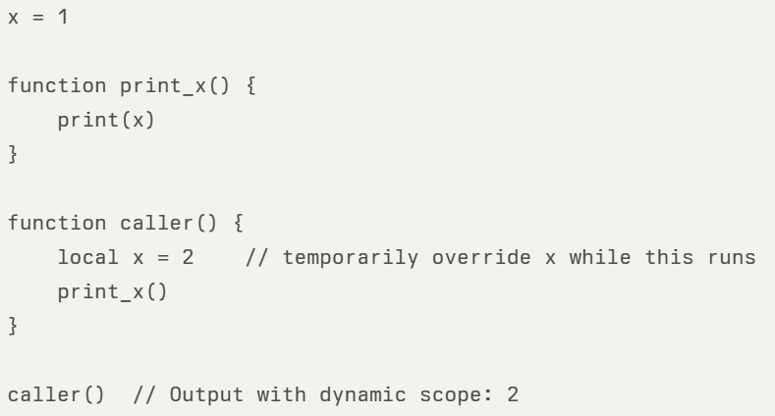
Dynamic scope – defined at runtime
With static scope, print_x() would see x = 1 (where it's defined).
With dynamic scope, print_x() sees the most recent x, which in this case is 2 from caller—because caller was the caller on the stack.
Modern languages have abandoned dynamic scope. Why?

